Slide 1
Okaloosa County Sheriff’s Office Fiscal Year 2015 Budget Sheriff Larry R. Ashley Submitted June 1, 2014

Slide 2
Consolidated Budget
 | FY 2007 Approved | FY 2010 Approved | FY 2013 Approved | FY 2014 Approved | FY 2015 Administrator Recommendation 1 million
Budget | $32,971,648 | $31,051,700 | $28,098,890 | $30,294,780 | $31,098,890
Cumulative Change Since FY 2007 |  | ($1,919,948) | ($4,872,758) | ($2,676,868) | ($1,872,758) Down 5.6%
Residential Population | 182,760 |  |  | 190,809 | Up 4.4%
Tourist Population /Bed Tax Collections | $10.4 Million |  | $13.5 Million |  | Up 30%
Consumer Price Index* | 200.3 |  | 226.7 |  | Up 13%
Cost of a Chevy Police Sedan (Base FSA contract) | $17,193 | (Not Equipped) |  | $20,634 | Up 20%
Calls for Service | 162,461 |  | 213,488 |  | Up 31%
Vehicle Maintenance Costs | 365,748 |  | 440,442 |  | Up 20%
Average fuel cost | $2.78 |  |  | $3.55 | Up 33%
Notes:
* South Urban, All items

Slide 3
10 Factors We Must Consider in Preparing Our Budget
Resident and Tourist Populations
Number of Calls For Service
Crime Rates and Crime Prevention Programs
Emergency Response Times and Citizen Safety
CPI - Personnel, Fleet, Fuel, Energy, Communications, Technology, Ammunition and Equipment Cost
Officer Per Thousand Citizen Ratio
Per Capita Cost
Turnover Ratio
Officer Training & Safety
Ability to Respond and Solve Crimes Against our Citizens
Notes:
My question to you is this?
If not this data, what data or formula will this Board utilize in determining the number of deputies and civilian employees required to accomplish our mandate of providing law enforcement services to the citizens and visitors of Okaloosa County? What data will you use to determine the amount of fuel or electricity or other operational cost needed? What data, formula or comparative analysis will this Board utilize when determining the merits of our budget proposal? What data did you use to determine EMS increase?

Slide 4
OCSO Law Enforcement Costs
The Okaloosa County Sheriff's Office provides a strong, professional law enforcement product at a very cost efficient price to the citizens of Okaloosa County. Our per capita costs are 43% less than the national average for agencies serving a similar population size. This does not include or account for the tourist population
For 2013 the average per capita costs for an agency that serves between 100,000 to 249,000 was $286. The Administrator’s Recommendation for the FY 2015 budget is $163 per capita based on the 2013 population estimate of 190,083.
The International City/County Managers Association Annual Report, and the Municipal Yearbook, provides national per capita cost statistics based on population.
Notes:
County Parks $18 per year,

Slide 5
Personnel Allocation
FY 2013 saw a 11.3% cut in personnel due to reductions in revenue and increased operational costs. The 2013 average of 3.12 sworn officers for the South Atlantic Region and 2.26 national average are well above our current ratio.
The Administrator’s recommendation would only provide for 1.35 sworn officers per thousand citizens in the coming FY 2015 budget.
Over half of our patrol deputies have 3 years or less of experience.

Slide 6
Annual Call Volume Increase
Sheriff’s Office law enforcement activity in Okaloosa County.
Year | Total Incidents | Increase/Decrease
2007 | 162,471 | -
2008 | 173,747 | 11,276 (7%)
2009 | 172,708 | 1,039 (<1%)
2010 | 177,748 | 5,040 (3%)
2011 | 184,697 | 6,949 (4%)
2012 | 210,175 | 25,478 (14%)
2013 | 213,488 | 3,313 (1.5%)
31.4% Increase in Call Volume since 2007

Slide 7
Average time on calls in minutes
BAKER ACT- 146.5 = 2 hours 26 minutes
BURGLARY- 144.36 = 2 hours 24 minutes
DUI- 201.57 = 3 hours 21 minutes
DOMV- 232.5 = 3 hours 52 minutes
THEFT- 136.28 = 2 hours 16 minutes
CRASH NO INJ- 117.35 = 1 hour 57 minutes
CRASH INJ OR F- 413.5 = 6 hours 53 minutes
WARRANT- 117.5 = 1 hour 57 minutes
MM NARC- 136.83 = 2 hours 16 minutes
FELONY NARC- 241.1 = 4 hours 1 minute
Time includes on-scene time, report writing, evidence processing and transportation to jail when required.
Notes:
Police Chiefs Assocaition Recommended Time Utilization Formula requires 1/3rd time for response to calls, 1/3rd time for follow-up or investigation of cases, and 1/3rd of time for proactive or preventive measures. With current manpower allocation we struggle to keep up with calls and investigations with no time for proactive and preventive patrol.

Slide 8
OCSO Deputies Injured Due To Assault
Law Enforcement Assault Statistics
Nationally 10% of law enforcement officers were assaulted in the line of duty during 2012.
OCSO Deputies Injured in Assaults Annually
2014 – 20 15.6% Estimated (Semi Annual) 2013 – 36 14.8% 2012 – 32 13.1% 2011 – 29 11.0% 2010 – 24 9.3%
The OCSO is 5.6% above the national average for injured officers as a result of assault. It is no coincidence that having 37% fewer officers per thousand citizens affects officer safety.
Notes:
OCSO had 50 Deputies injured due to assault in FY 2011 which equates to the 19 per 100 or 19% injury ratio/rate.

Slide 9
OCSO Deputies are dealing with 74.59% more violent encounters (resisting with violence) than just two years ago.
OCSO Violent Encounters
2011 – 185 violent encounters by Deputies
2012 – 254 violent encounters by Deputies
2013 – 323 violent encounters by Deputies
Notes:
2011 = 185 incidents 2012 = 254 incidents 2013 = 323

Slide 10
OCSO Fleet Condition
The Okaloosa County Sheriff's Office tries to maintain a fleet of capable and reliable vehicles which support law enforcement operations. Our fleet has approximately 300 vehicles that are critical to the daily emergency operations. We should be replacing them at 5 years or 100,000. That would be about 60 vehicles a year.
Our agency is currently 155 vehicles behind 5 year replacement schedule going into 2015
At the current state contract amount of $20,634 per vehicle, this total equals $3.2 million dollars to bring our fleet into compliance with replacement schedule. This does not account for police outfitting of the vehicles at approximately $6,000 per vehicle or $1 million dollars
Notes:
Industry Standard

Slide 11
OCSO Fleet Decline
Cost trends will continue to rise, 20% increase since 2008, absent a proactive fleet replacement plan. “Dependability is a life saving requirement for law enforcement.”
Currently 1/2 of our fleet has 100k or more miles and is 6 years or older.
*in thousands

Slide 12
OCSO Technology Decline
We have a 43% failure rate in current in car video systems . Correction cost $776,000
We need to replace 45 MCTs and 30 tablets at a cost of $300,000
We need 9 Intox & Interview rooms repaired for audio/video, replacement, and/or upgrades at a cost of $85,000
Notes:
We need to replace approximately 45 MCTS annually to at approximately $3,000 each or $135,000
Software licensing is approximately ????

Slide 15
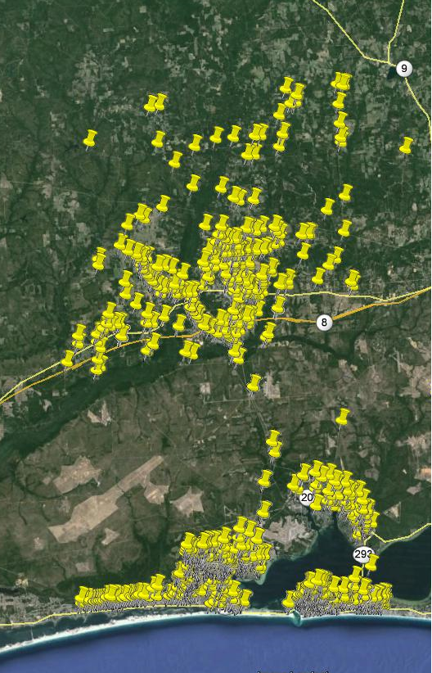
2013 Okaloosa County Traffic Reported Crashes 5,757

Slide 16
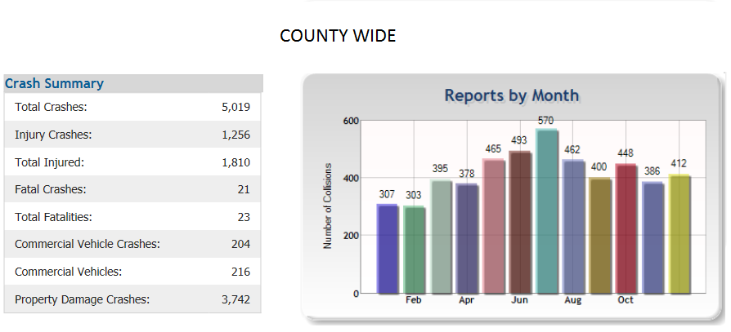
2013 Okaloosa County Traffic Crashes
Received 5,757
Responded 4,616 Average time 33.6 minutes
Investigated 1,175
Average time on call w/out injuries: 1 hour 57 minutes
Average time on call with injuries: 6 hours 53 minutes
Notes:
Average Time on call prior to relinquishing to FHP 33.6 minutes
w/injury 6 hrs 53 minutes
w/o injury 1 hr 57 minutes

Slide 17
OCSO Bed Tax Jurisdiction Annual Calls For Service
Annual Calls | For Service
District Zone | 2009 | 2010 | 2011 | 2012 | 2013
Zone 24 | 10154 | 11095 | 11509 | 13357 | 12975
Zone 25 | 18755 | 18688 | 21210 | 23065 | 23715
Zone 26 | 8624 | 7928 | 8246 | 8170 | 8545
Zone 27 | 6168 | 6745 | 8257 | 9155 | 9307
Grand Total | 43,701 | 44,456 | 49,222 | 53,747 | 54,542
OCSO Bed Tax Jurisdiction accounts for 26% of OCSO annual call volume while less than 12% of county residents reside in these patrol zones.

Slide 18
OCSO 2013 calls for service by month in bed-tax jurisdiction

Slide 19
OCSO 2013 Calls for service by week in bed-tax jurisdiction
.

Slide 20
Questions ?

